Slide 1

Relationships
Presented by:
Elizer Ponio Jr.

Slide 2
Inheritance
Relationships between classes are important in object-oriented programming.
Classes and objects in object-oriented programming are built to model real-world entities.
The relationships between classes in object-oriented programming are built to model the relationships between real-world entities, that these classes represent.

Slide 3
Relationships in Java
Inheritance
Association
Aggregation
Composition

Slide 4
Inheritance
An “is a” relationship signifies that one class is a type of another. It is implemented in java using ‘extends’ and ‘implements’ keywords.
Example:
A cat is a type of pet.
A dog is a type of pet.
A rabbit is a type of pet.

Slide 5
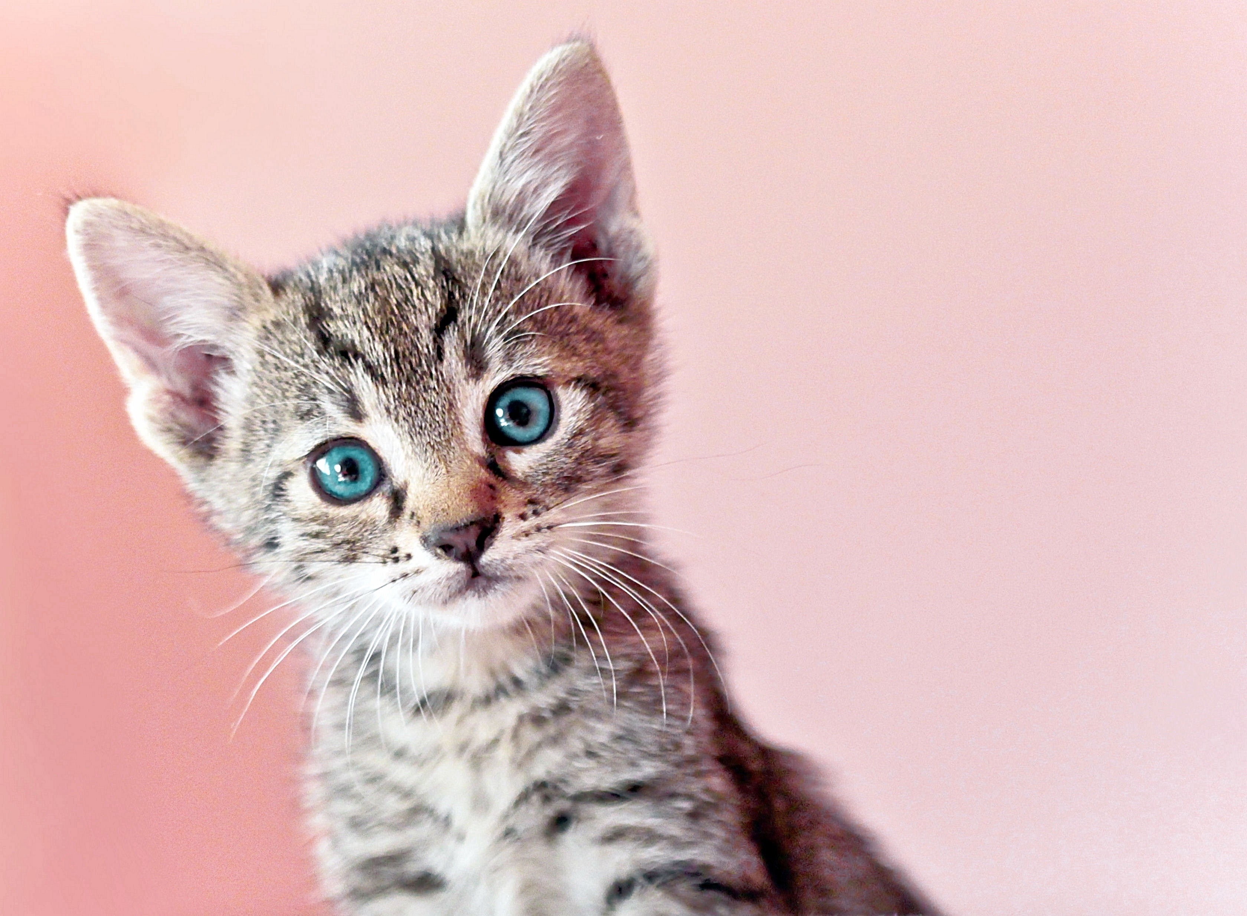

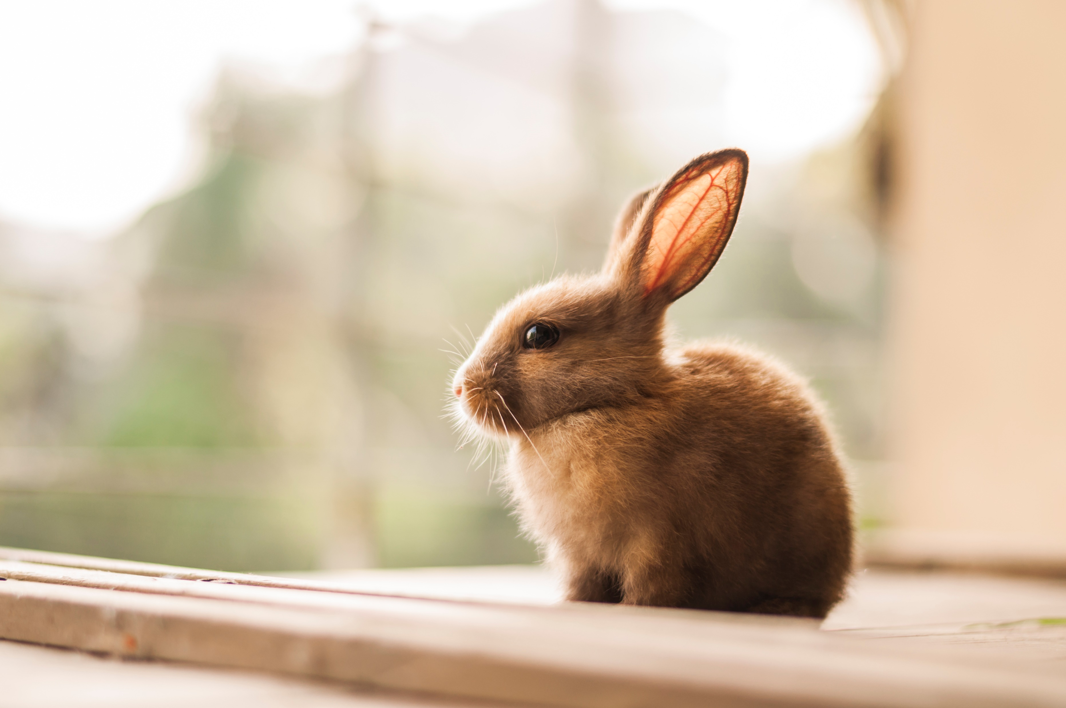
Inheritance
Pet
int name int age
setName() eat()
Cat
Dog
Rabbit
int name
int age
int name
int age
int name
int age

Slide 6
Inheritance
Pet
int name int age
setName() eat()
Superclass/Parent Class
Cat
Dog
Rabbit
int tailLength
Subclass/Child Class
Subclass/Child Class
Subclass/Child Class
You can add an attribute only specific to a subclass.

Slide 7
Inheritance
Pet
int name int age
setName() eat()
String birthday
Cat
Dog
Rabbit
If we add a new attribute, this will be applied to all subclasses.

Slide 8
Association
A basic relationship or connection between two separate classes.
Example:
A cat eats fish.

Slide 9
Association
Pet
int name int age
setName() eat()
Cat
Dog
Rabbit
eats
Fish

Slide 10
Types Association
One to one relation

Slide 11
Types of Association
One to one relation
Professor
Department
One professor can only be assigned to work in one department

Slide 12
Types of Association
One to many relation
Department
Professor
Department
One professor can be assigned to work in multiple departments

Slide 13
Types of Association
Many to one relation
Professor
Department
Professor
Multiple professors can be assigned to work in one department.

Slide 14
Types of Association
Many to many relation
Professor
Department
Professor
Department
Multiple professors can be assigned to work in multiple department.

Slide 15
Aggregation
In aggregation, each class have independent existence and they are not tied to each other.
Example:
A wolf can be part of a pack but it can also survive on its own.

Slide 16
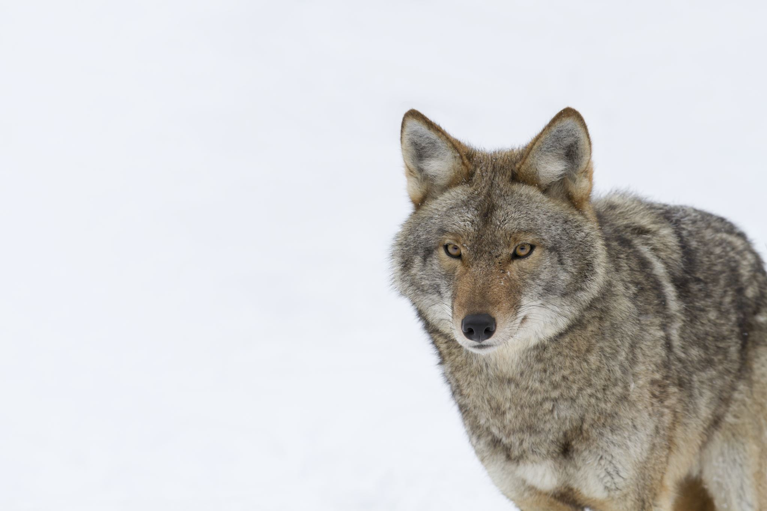
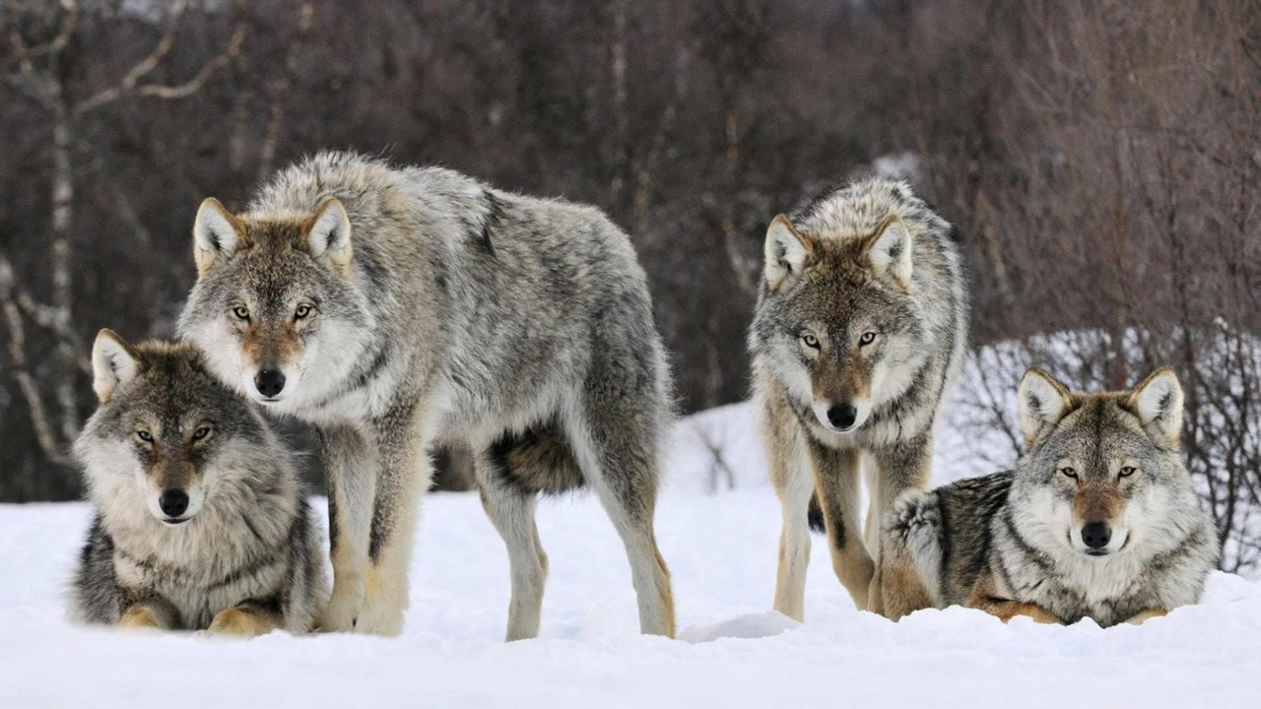
Aggregation
Wolf
Wolfpack

Slide 17
Composition
In composition, an object belongs to a larger object. If the larger object is destroyed, the all the objects in it will be also destroyed.
Example:
Plants and animals need water to survive. If there is no water, then there will be no plants and animals.

Slide 18
Composition
Water
Plants
Animals

